Slide 1
Face Detection
Mohammad Hammas Saeed and Shiza Ali

Slide 2
Problem Statement
OpenCV (Open source computer vision) is used for Face Detection, however, all C codes in OpenCV are serially executed.
Aim to implement a Face Detection Algorithm that is executed in parallel.

Slide 3
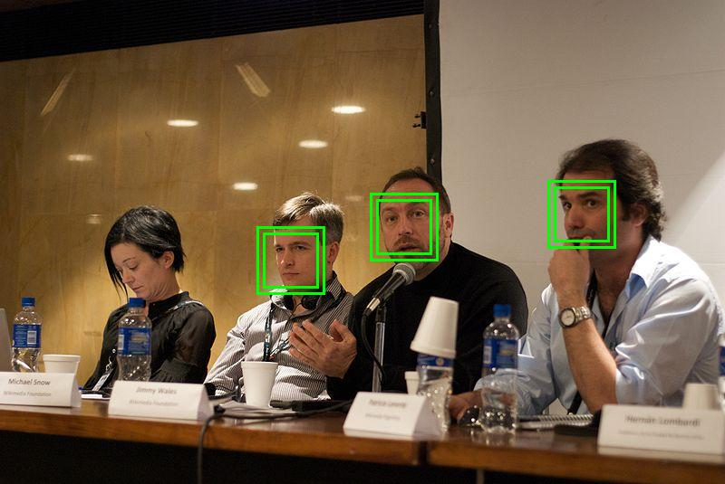
Face Detection
Identify human faces in digital images.
Automatic face detection is a complex problem in image processing.
https://en.wikipedia.org/wiki/Face_detection

Slide 4
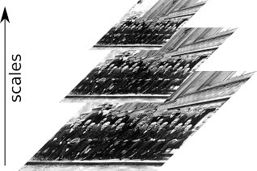
The Viola-Jones Algorithm - 3 Steps
Step 1: Image Pyramid
A Multi-scale representation of the image.
Allows detecting large and small faces using the same detection window.
Parallelization: Each pixel can be processed separately, so we produce image pyramid in parallel.

Slide 5
Continued...
Step 2: Integral Image
In the case of face detection, a sliding window (explained in the next step) shifts around the image, which needs to sum up pixels for each shifted window
For each pixel in the downscaled image, Integral Image computes the sum of all the pixels above and to the left of it.
Parallelization: Each row is independent of the other rows in the image and same is the case with columns. So we can leverage parallelism here.

Slide 6
Continued...
Step 3: Sliding Window
A window shifts around the image at each scale to detect the face.
Parallelization: Each sub-window has to pass through all the features, so we will parallelize them.
Step 4: Cascade Classifier
Each time the sliding window shifts, the new region goes through the cascade classifier.
The cascade classifier determines whether the region is a face.

Slide 7
Viola-Jones in Action
https://towardsdatascience.com/the-intuition-behind-facial-detection-the-viola-jones-algorithm-29d9106b6999

